Slide 1
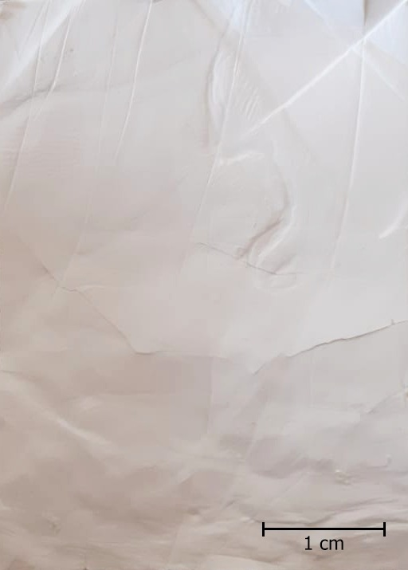
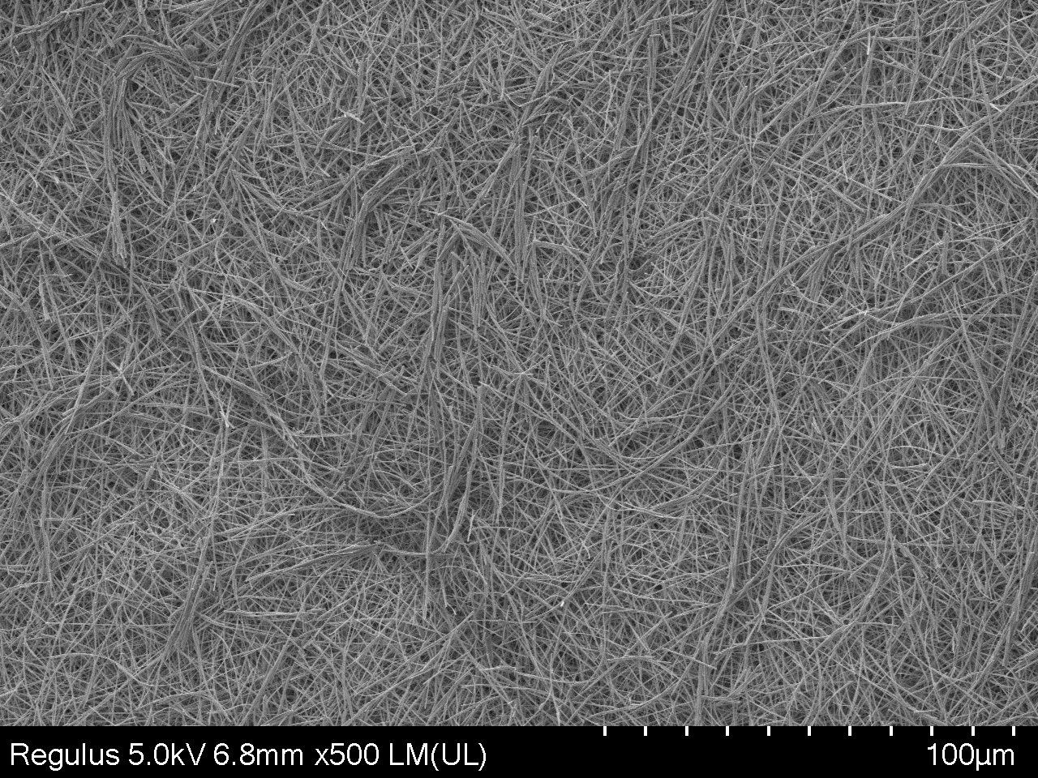
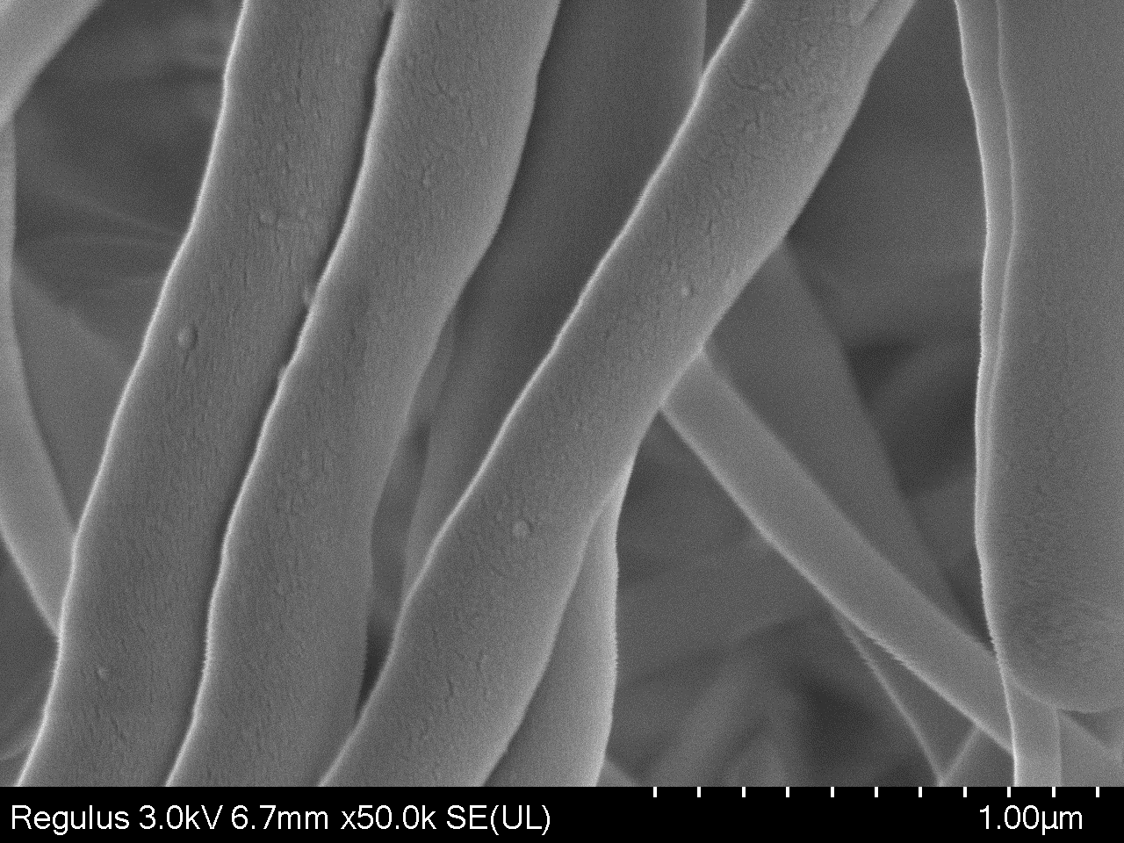
(a)
(b)
Tannic Acid (TA)
Tannic Acid (TA)-Fiber
(c)
Fig. 1. (a) Molecular structure of TA, (b) Digital and (c) SEM images of TA fibers with different magnifications.

Slide 2
(a)
100.0
(b)
TA Fiber
80.0
Crosslinked TA-Ibu Fiber
TA
TG %
60.0
Crosslinked TA Fiber
40.0
TA-Ibu Fiber
20.0
TA Fiber
0.0
200
400
600
800
1000
Temperature ℃
TA
(c)
TA Fiber
Crosslinked TA Fiber
TA-Ibu Fiber
Crosslinked TA-Ibu Fiber
4000
3500
3000
2500
2000
1500
1000
650
Wavenumbers (cm⁻¹)
Fig. 2. Thermal degradation profiles (a) TA molecule and TA fiber, and (b) TA-based fibers and (c) FT-IR spectra of TA-based fibers.

Slide 3
(a)
(b)
Ibuprofen
Fig. 3. (a) Degradation of crosslinked and non-crosslinked TA fibers, (b) Ibuprofen release % profile from crosslinked and non-crosslinked TA-Ibu fibers.

Slide 4
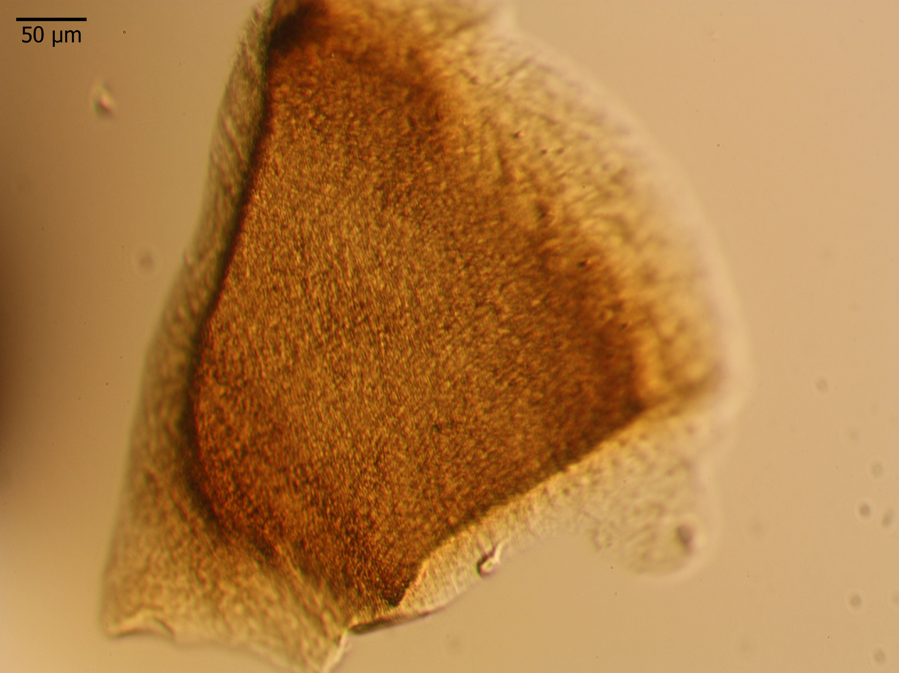
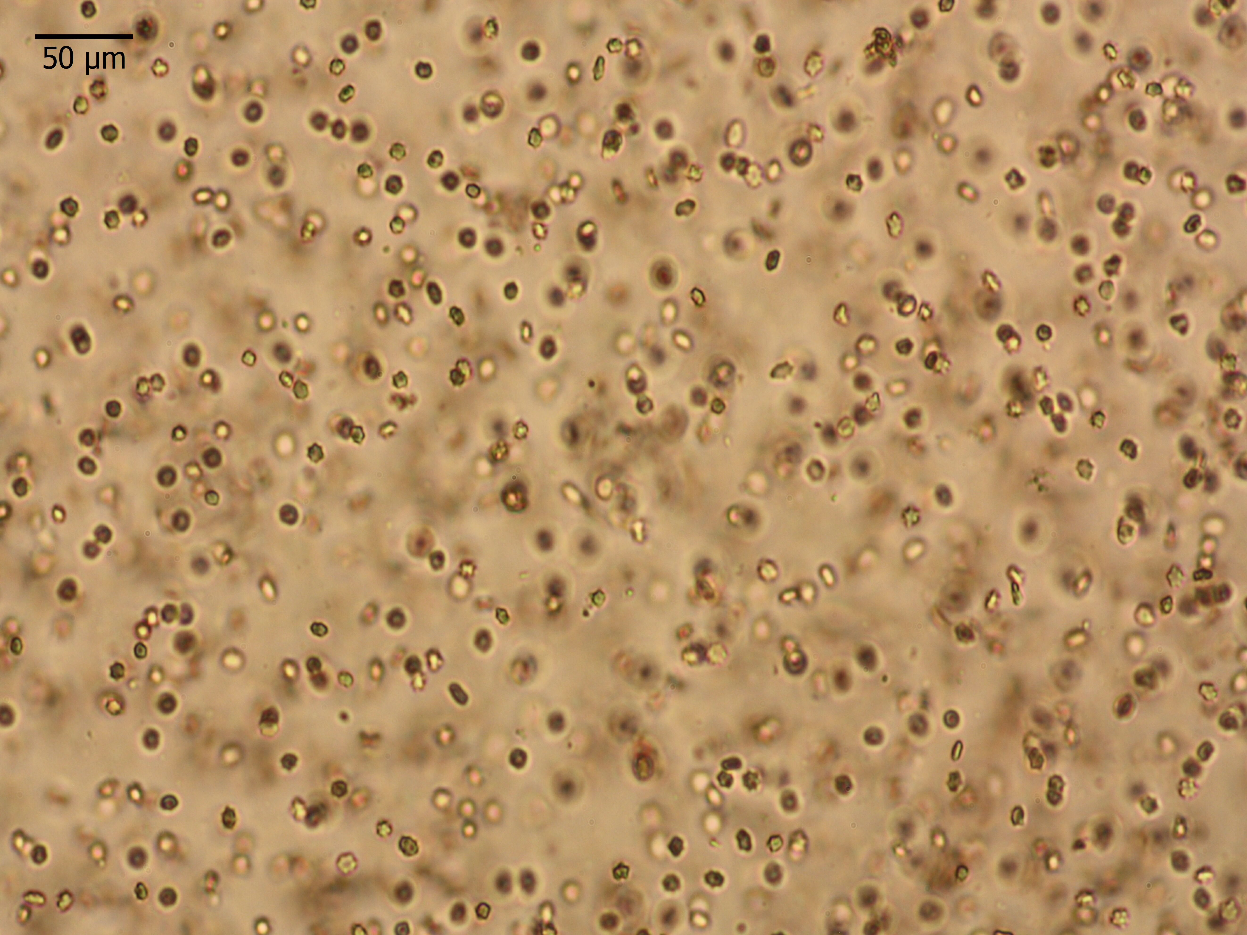
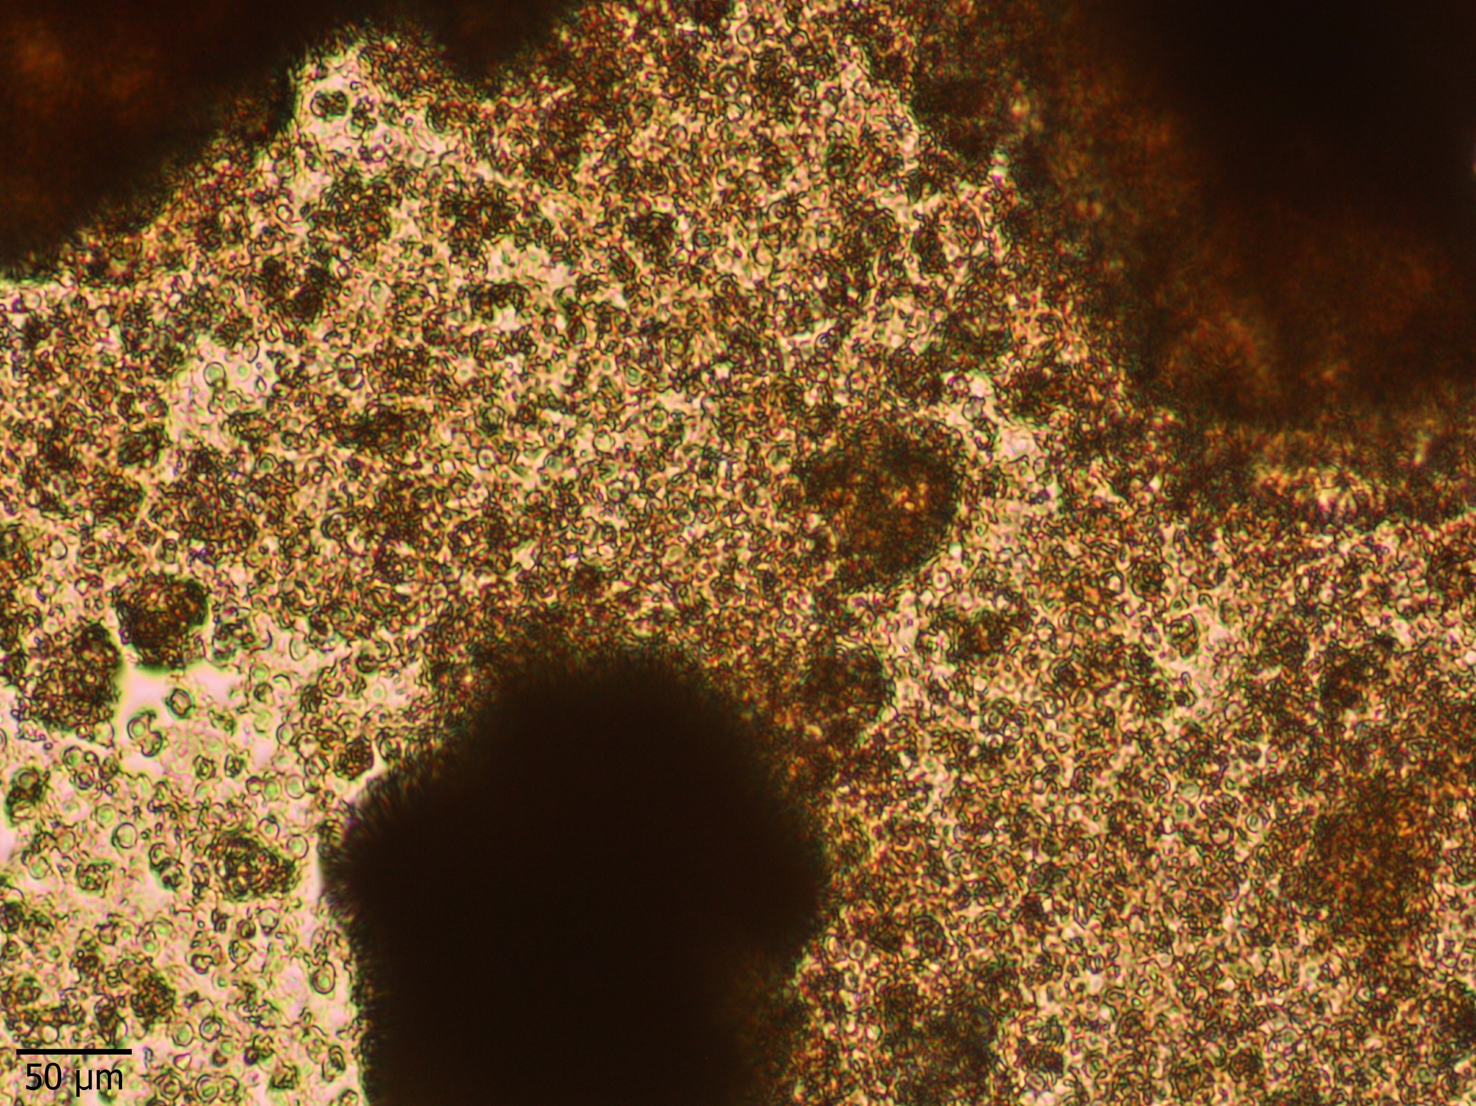
(a)
(b)
(c)
(d)
(e)
Fig. 4. (a) Hemolysis, and (b) blood clotting index of TA-based fibers at different concentrations, the microscope images of (c) crosslinked TA fiber, (d) red blood cells, and (e) red blood cells in the presence of non-crosslinked TA fibers.

Slide 5
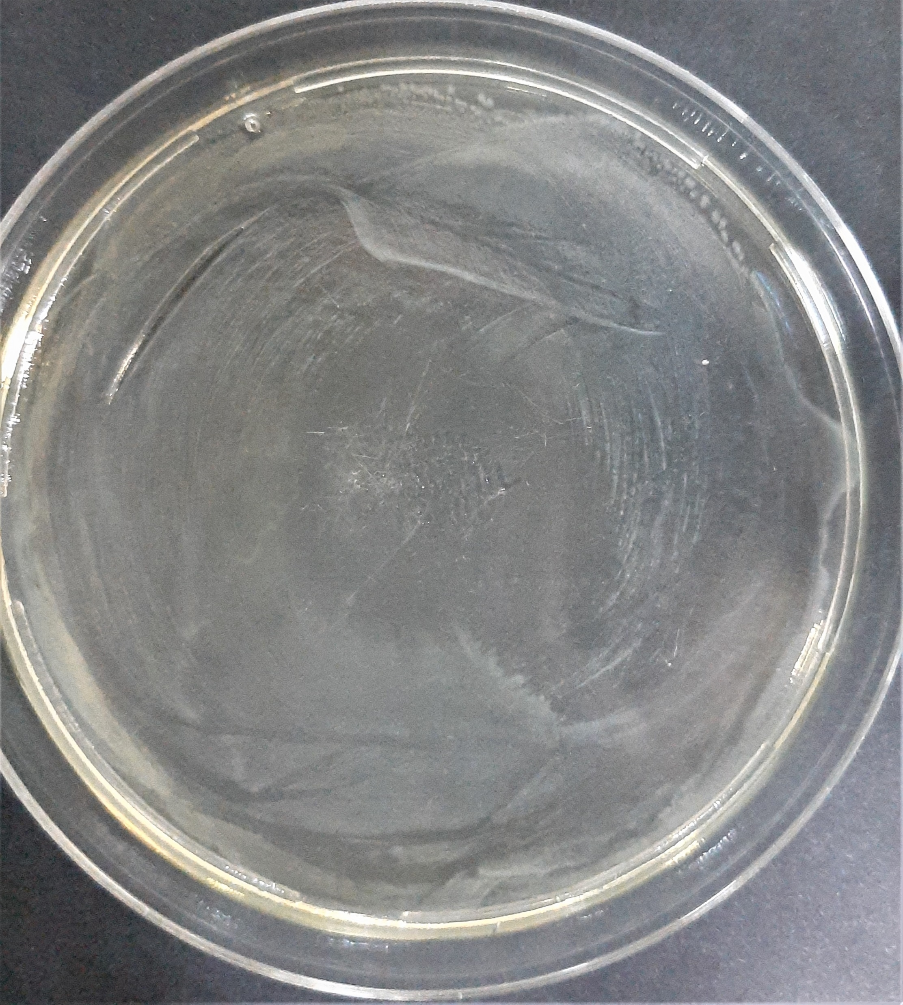
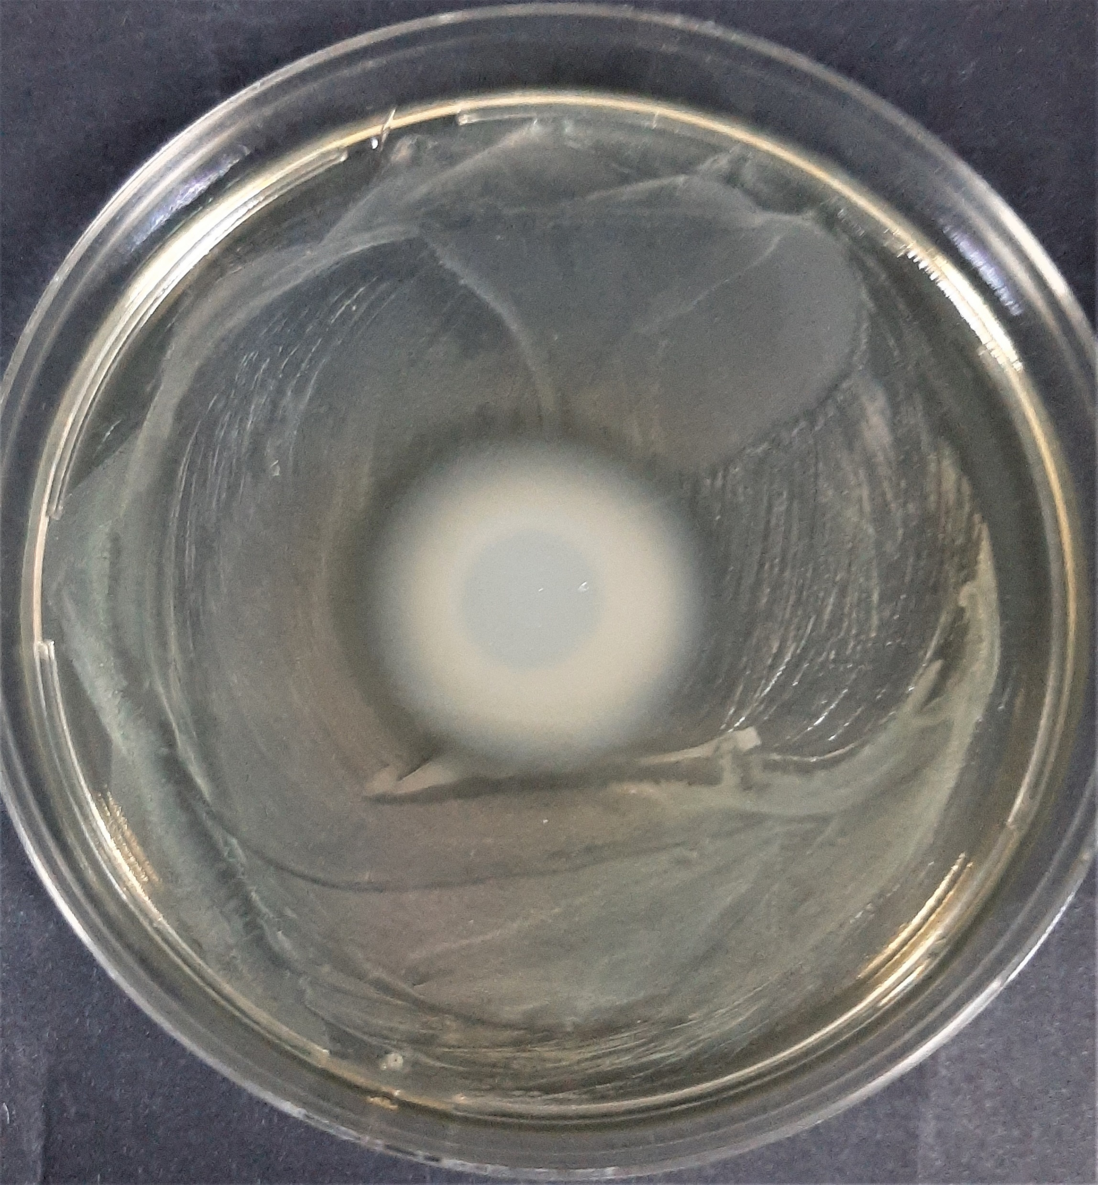
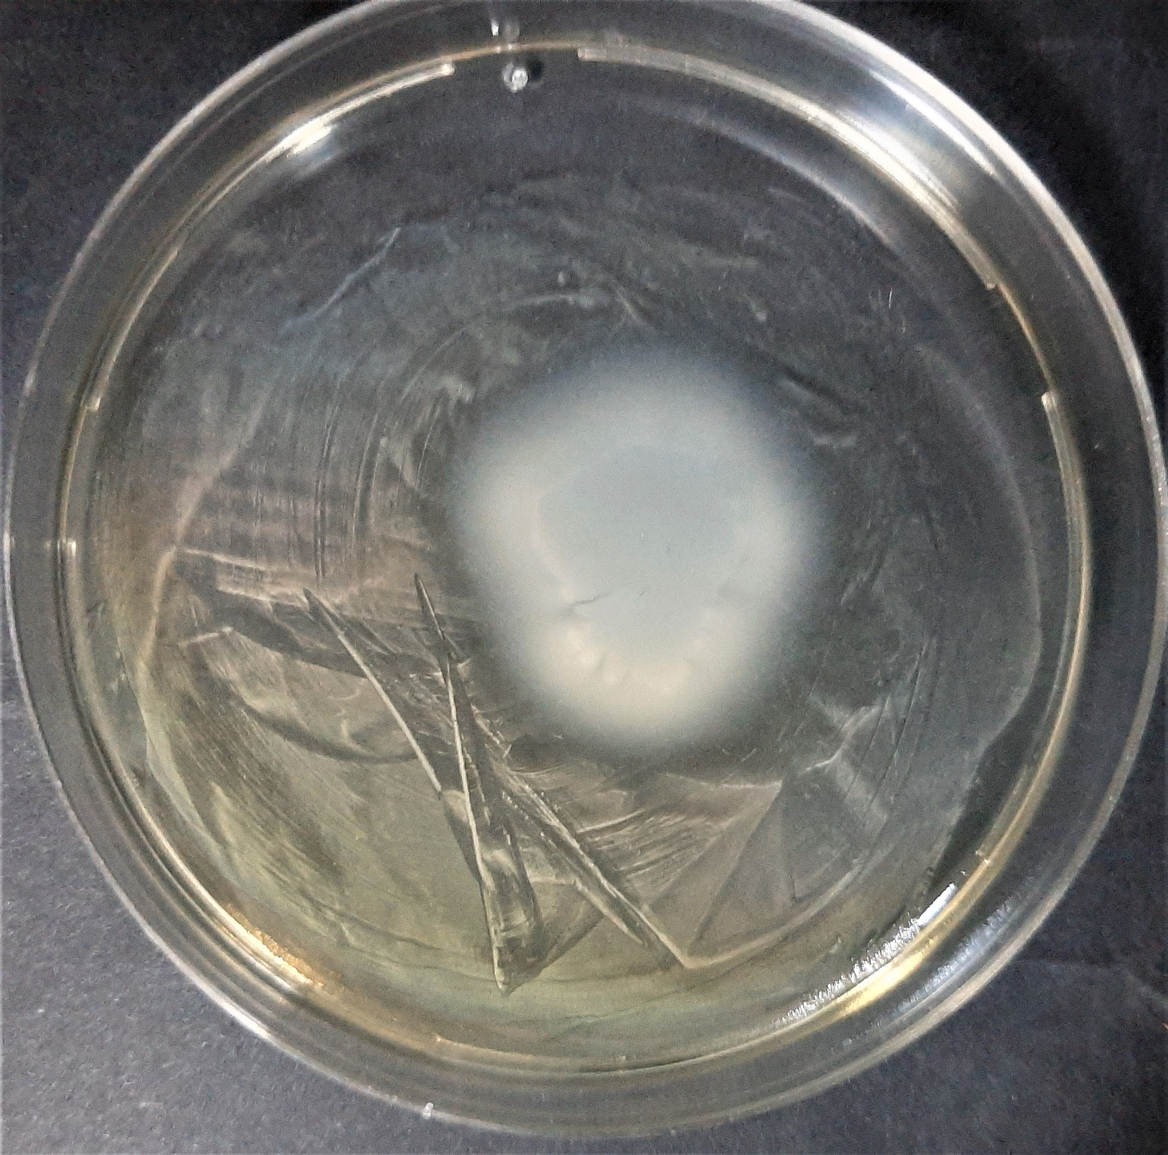
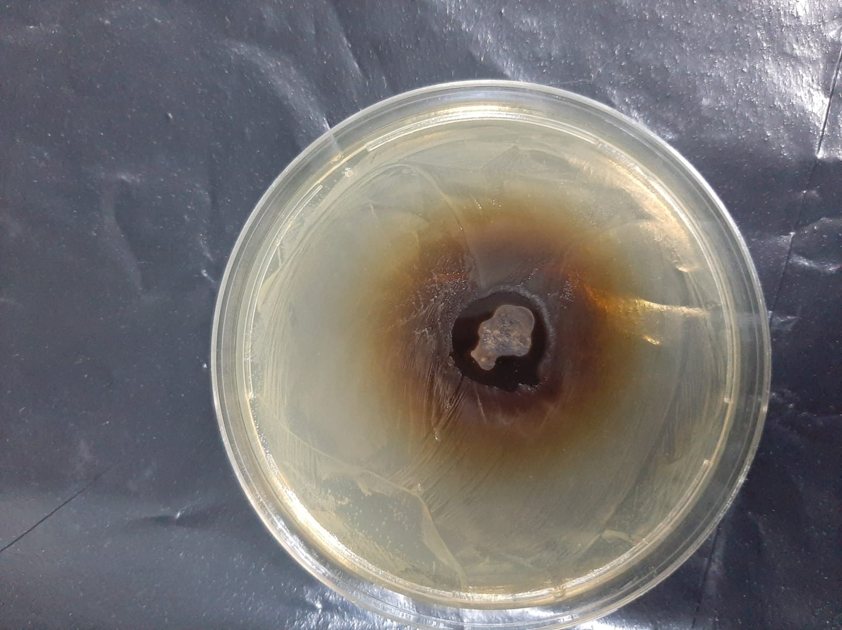
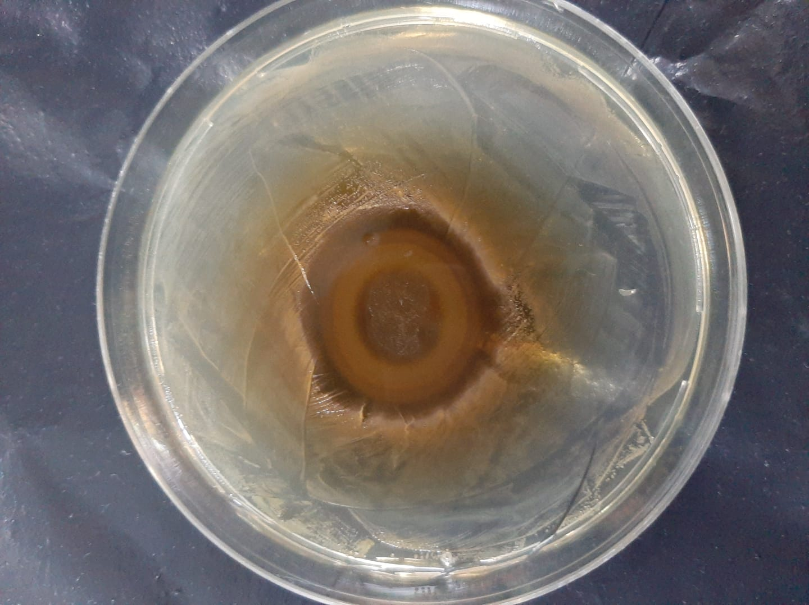
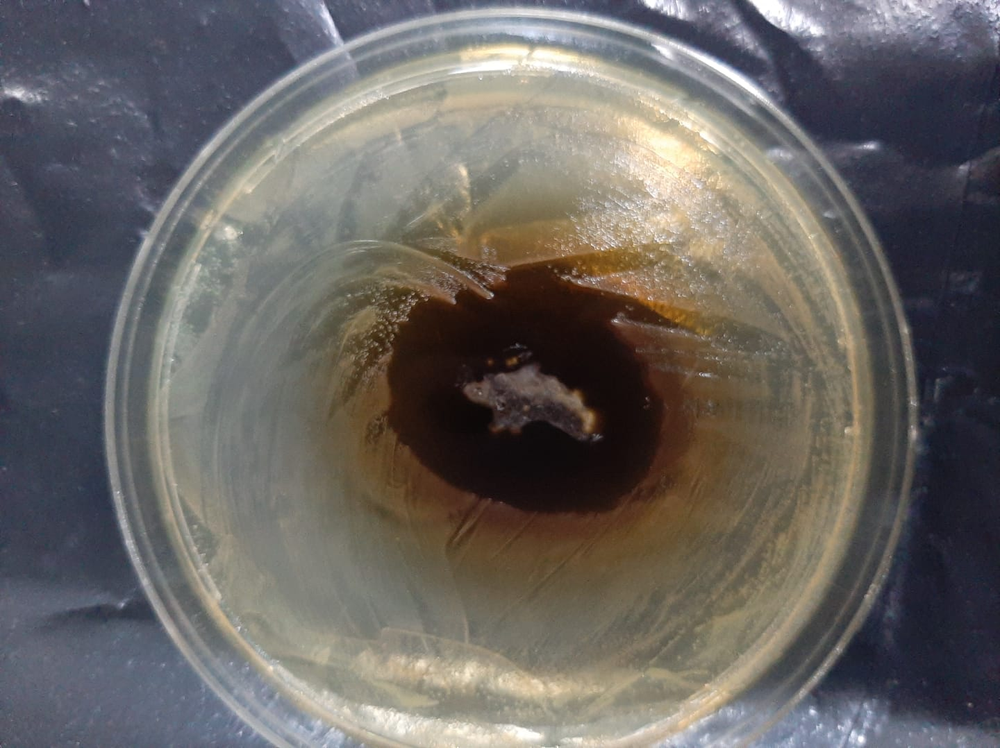
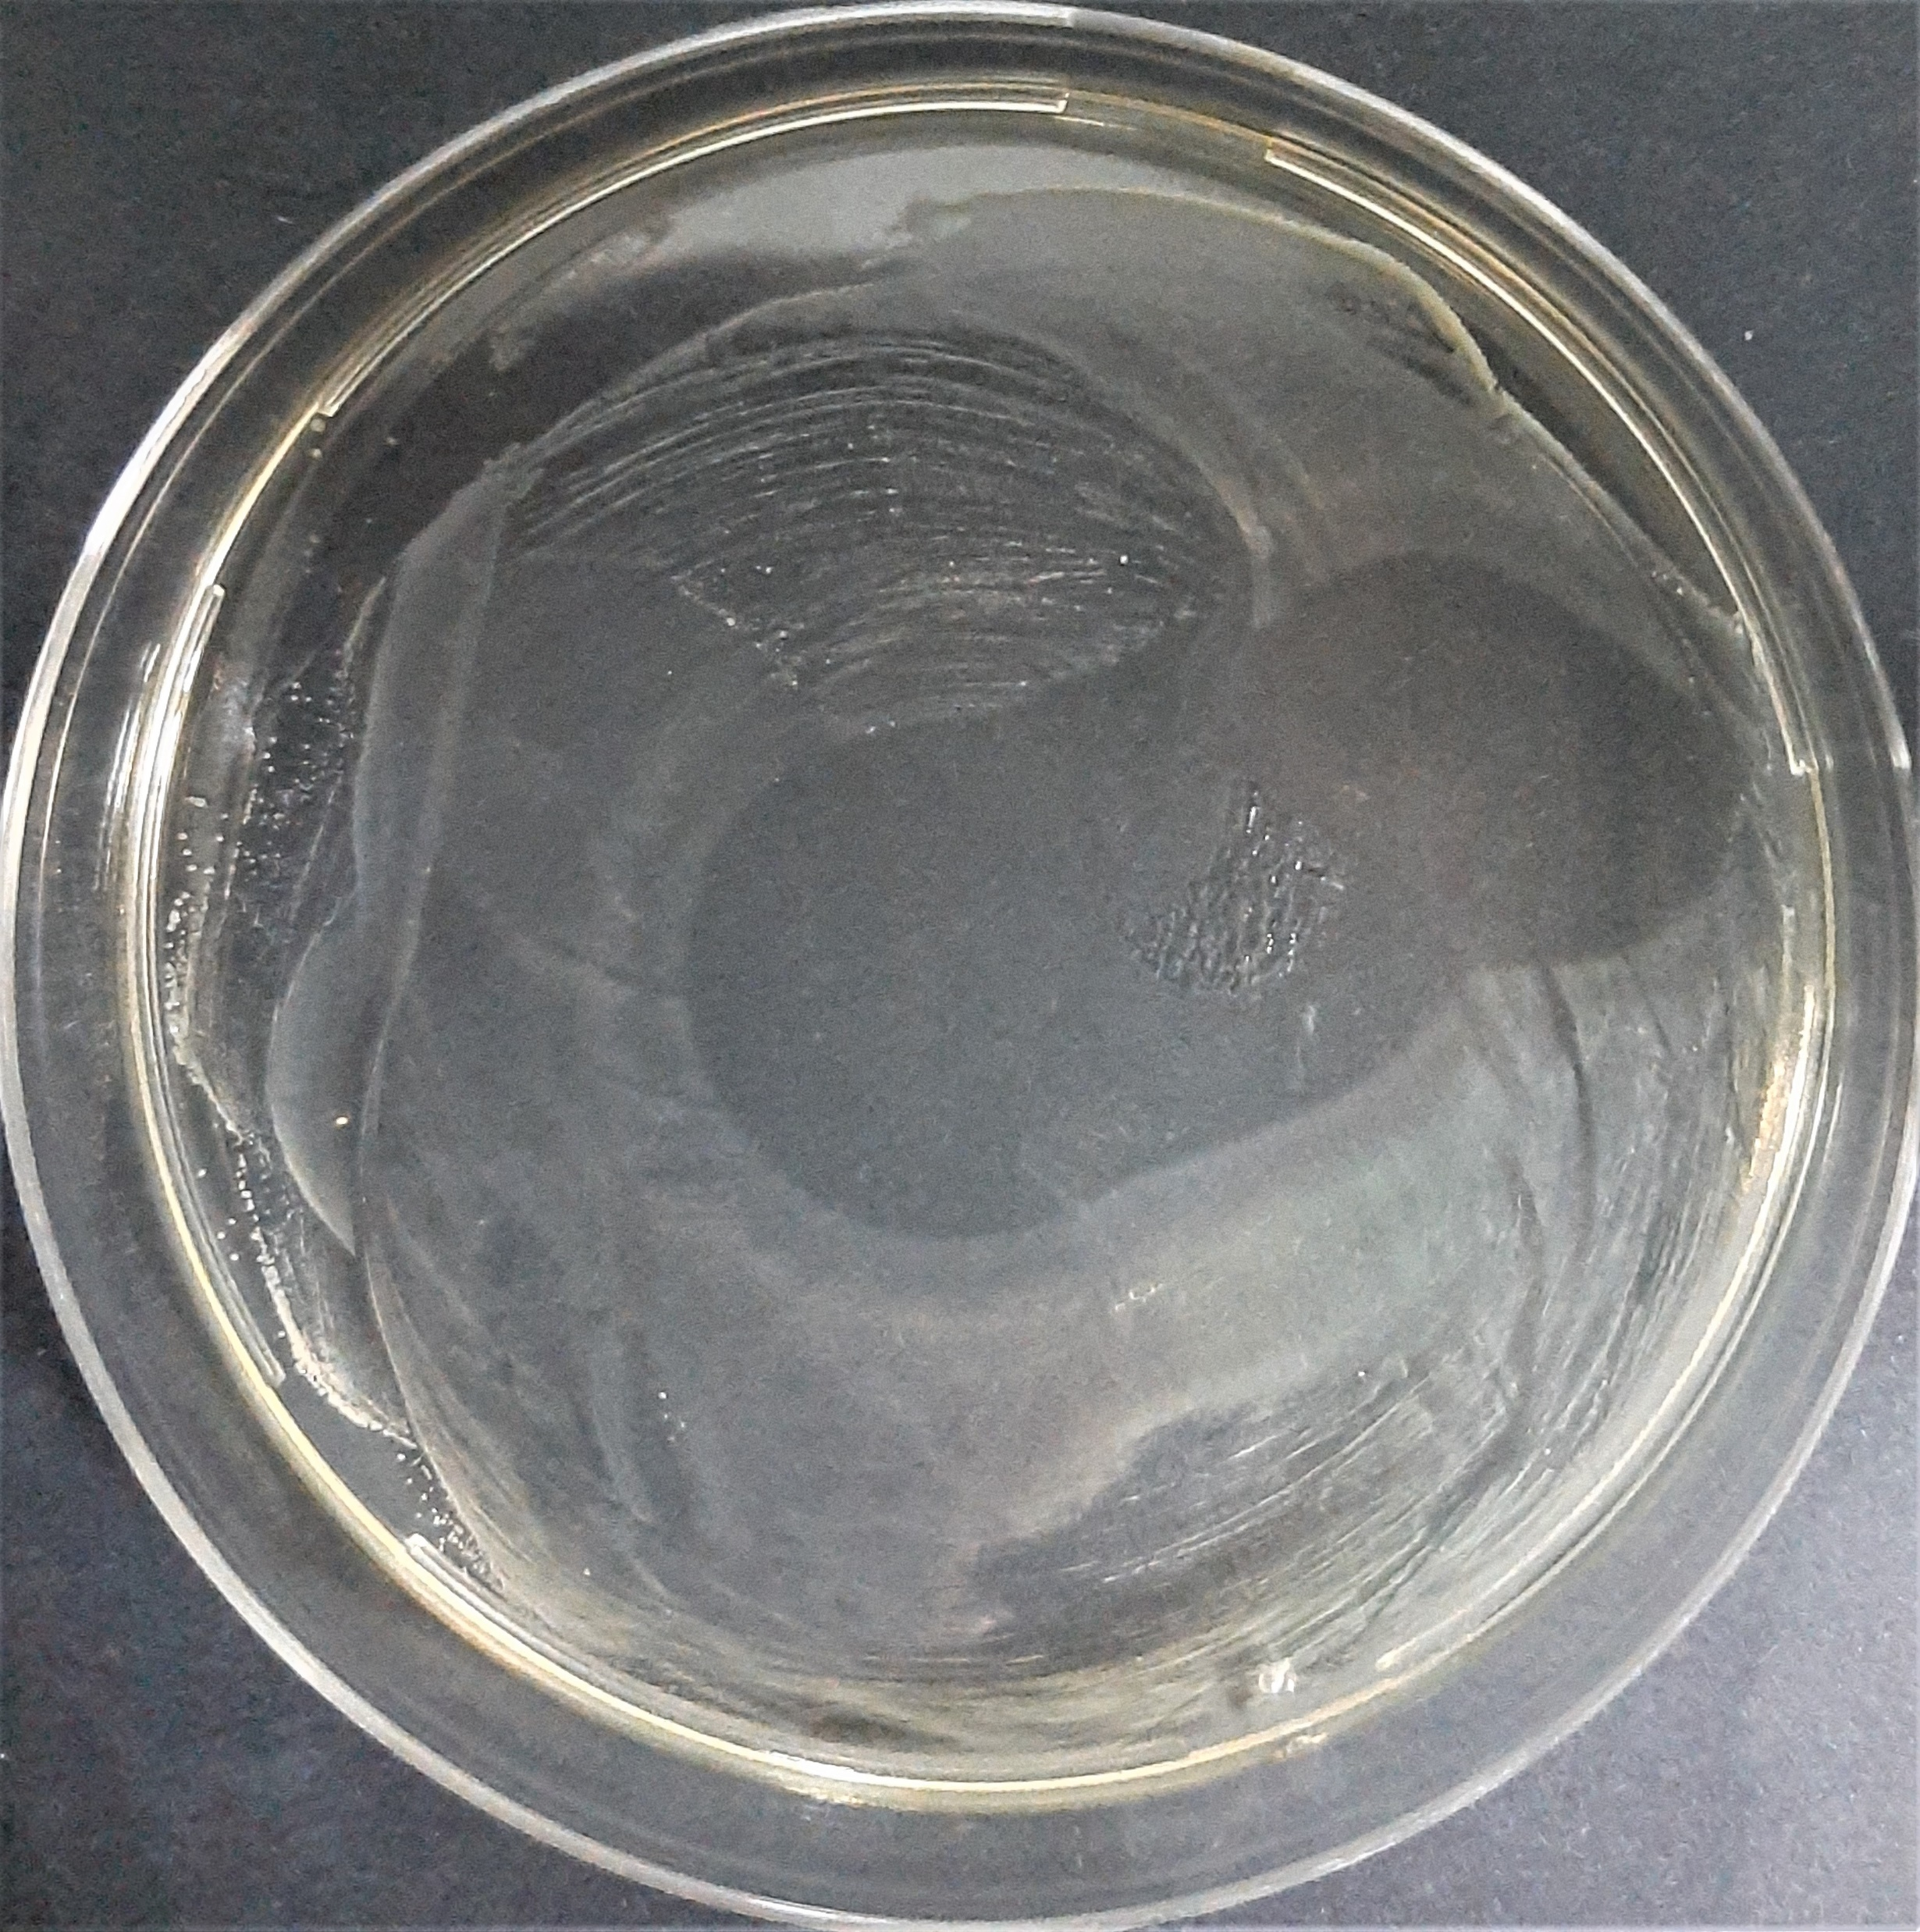
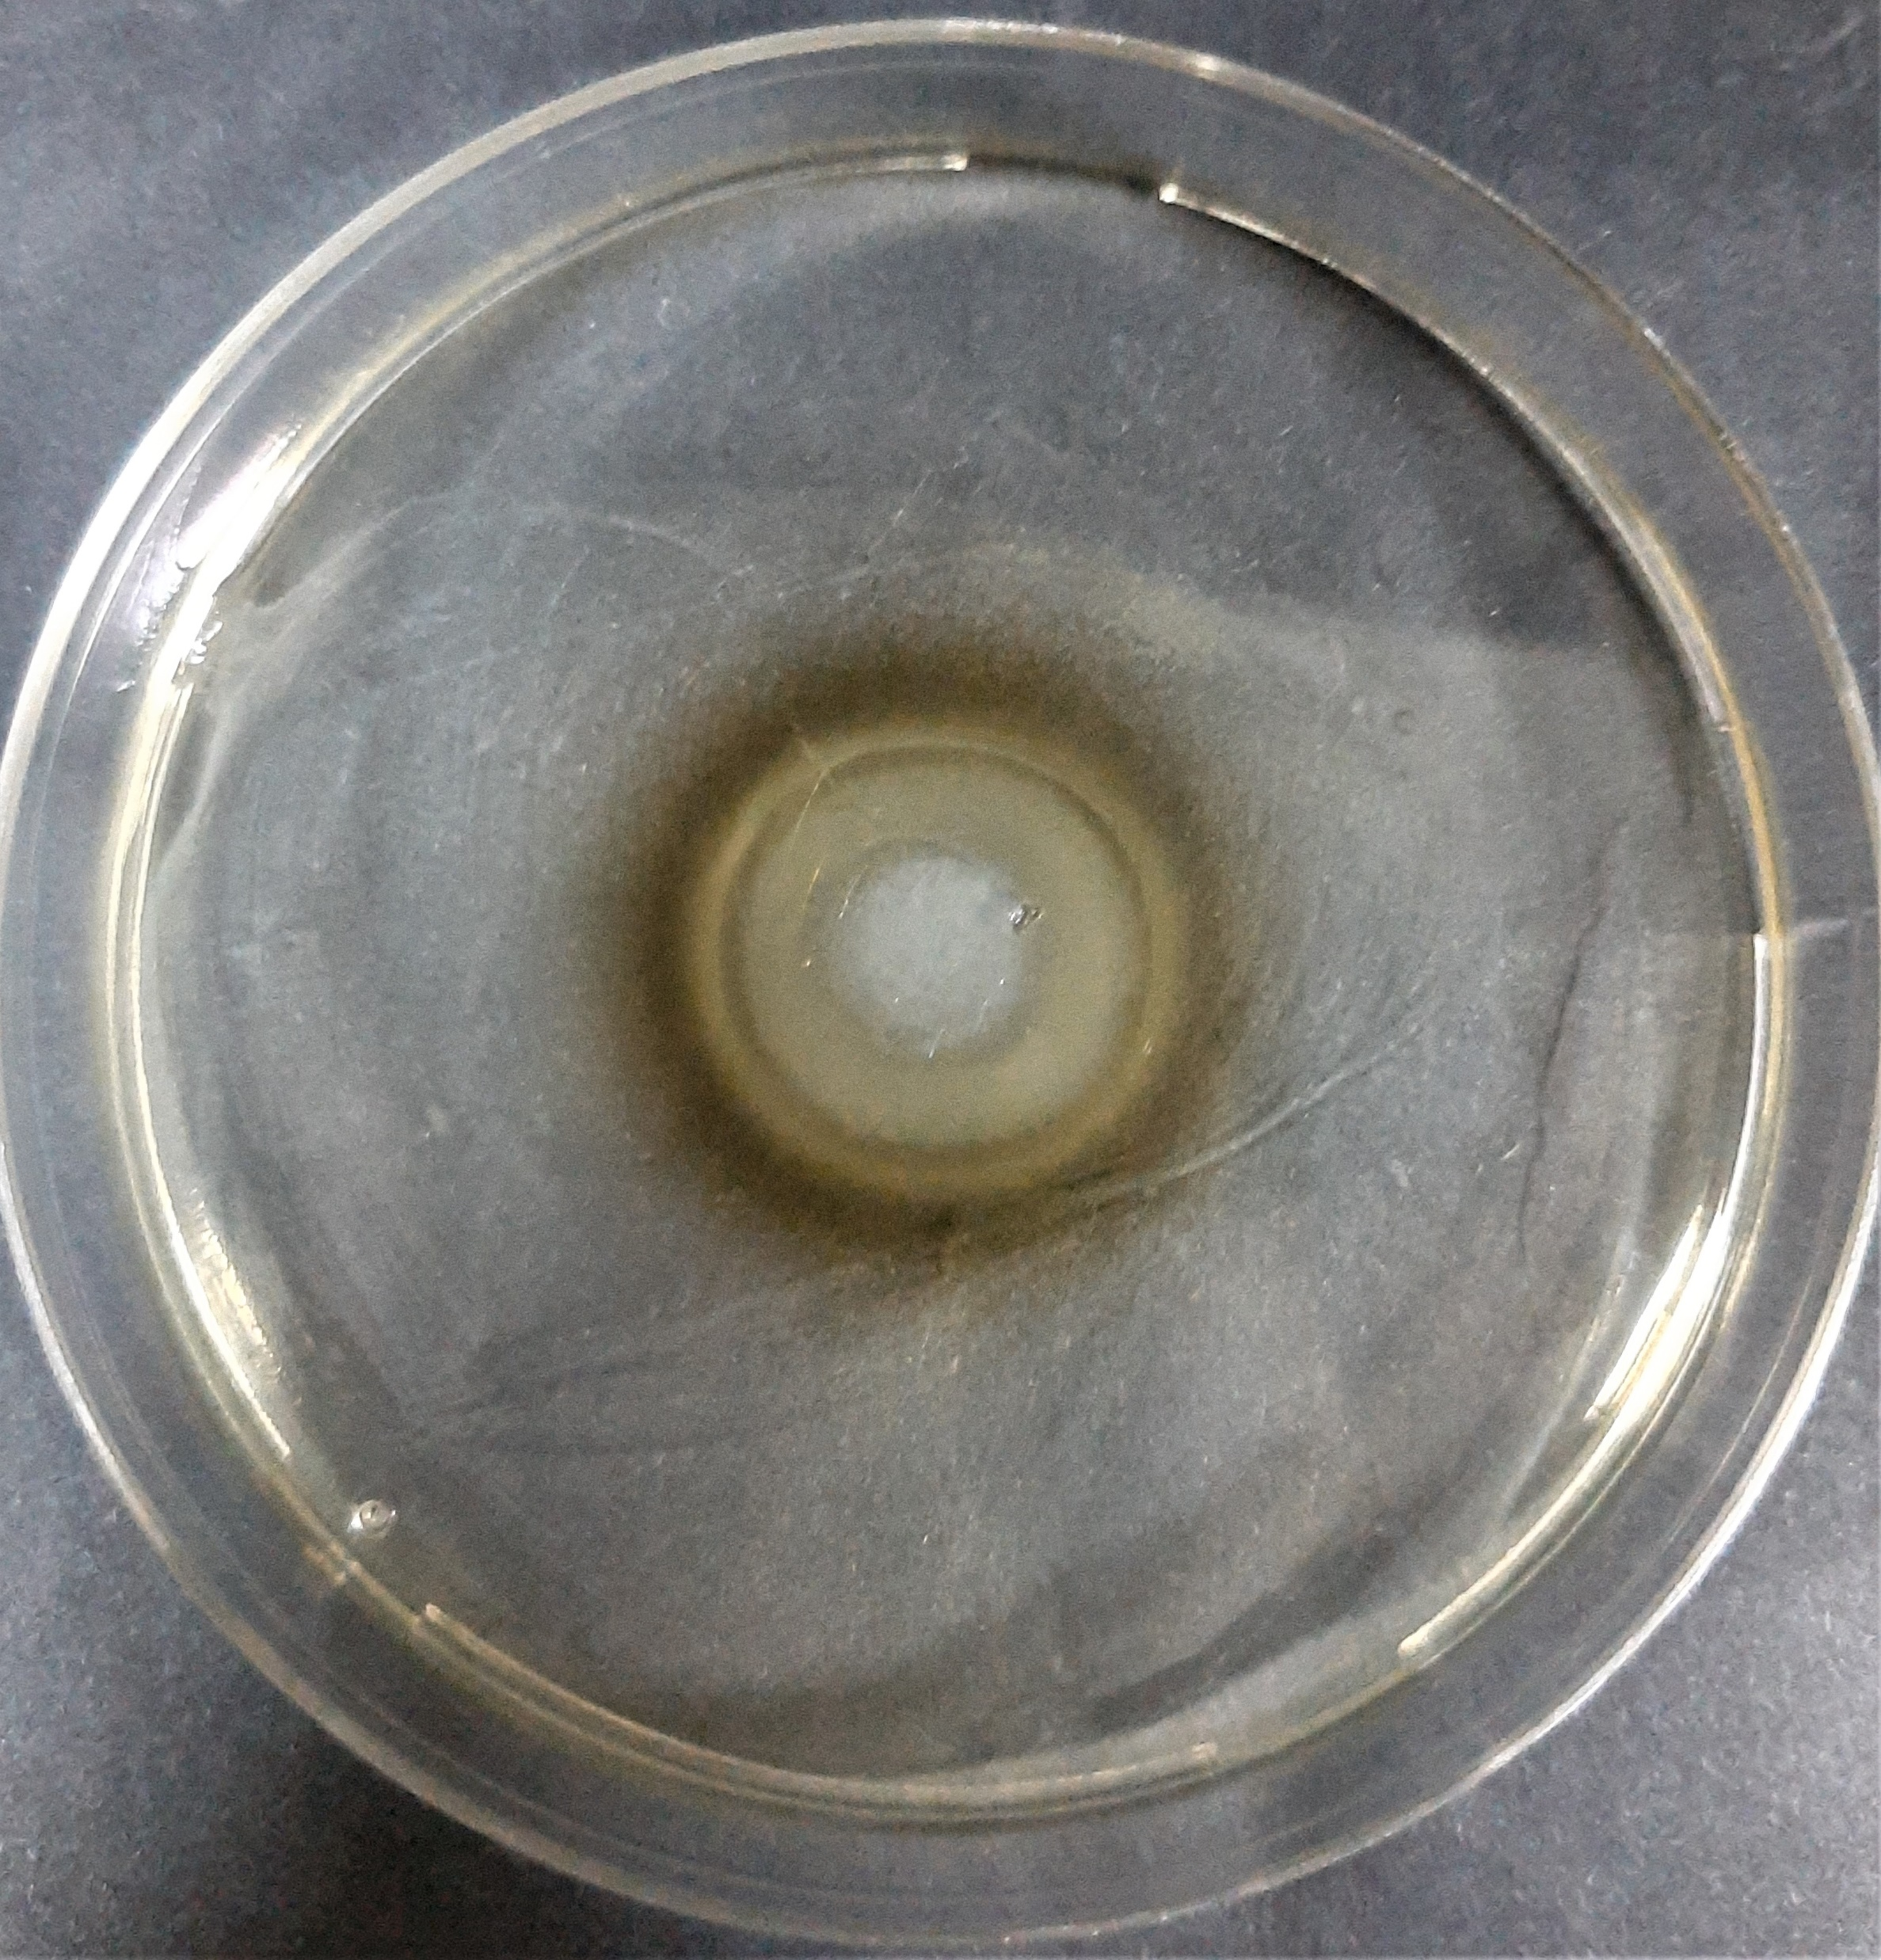
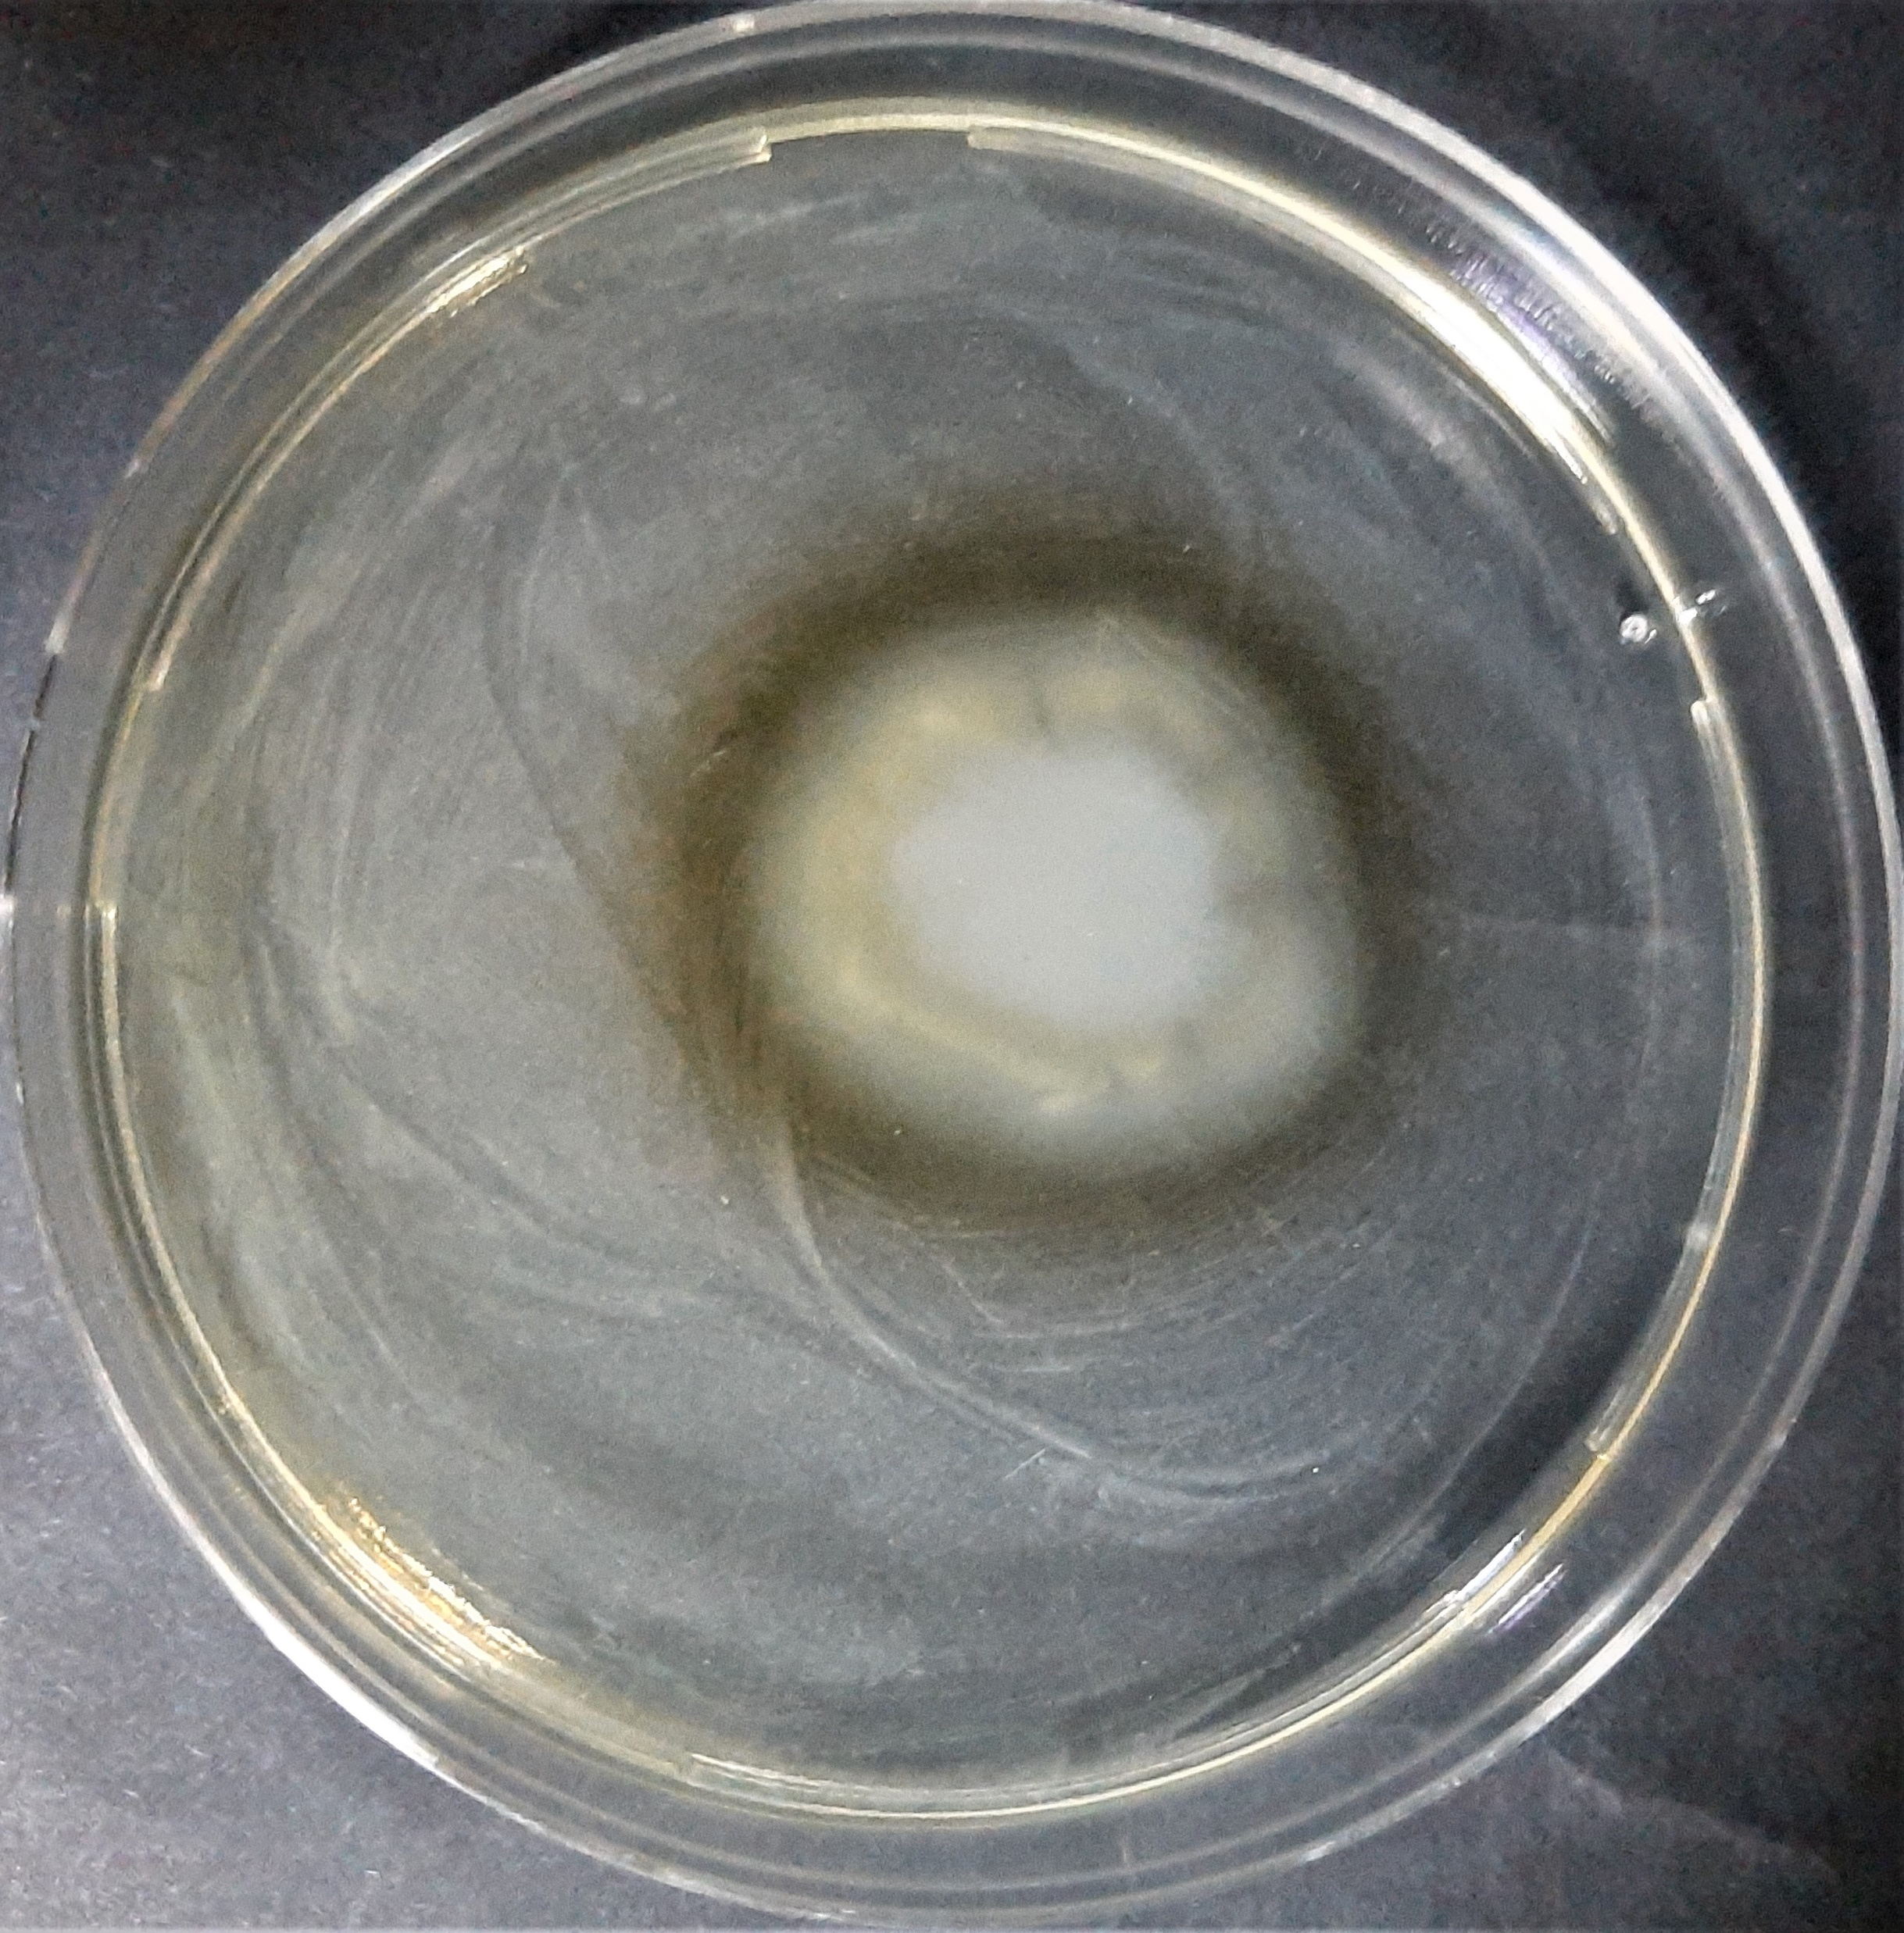
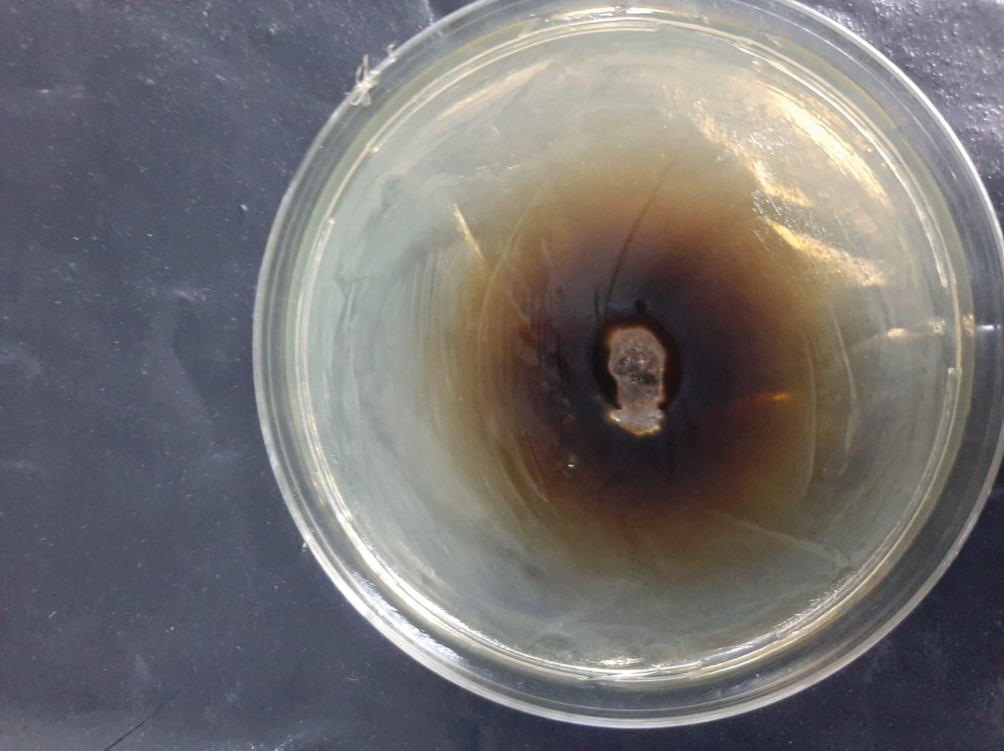
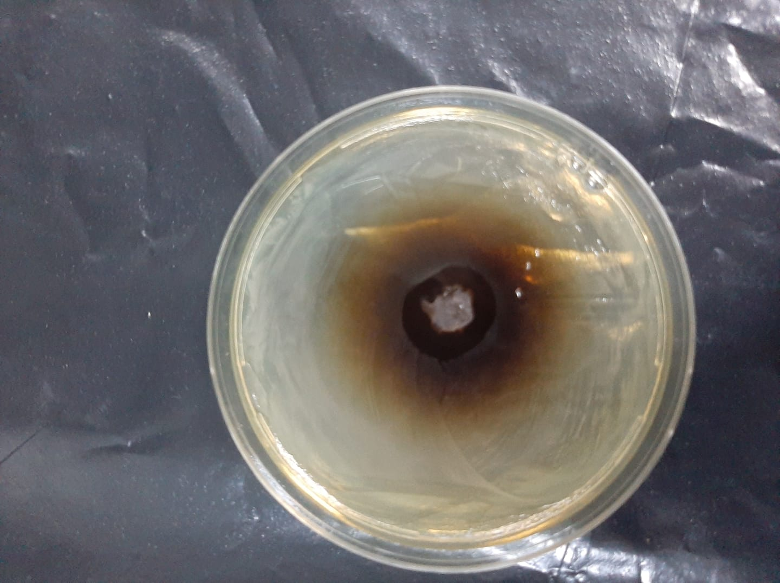
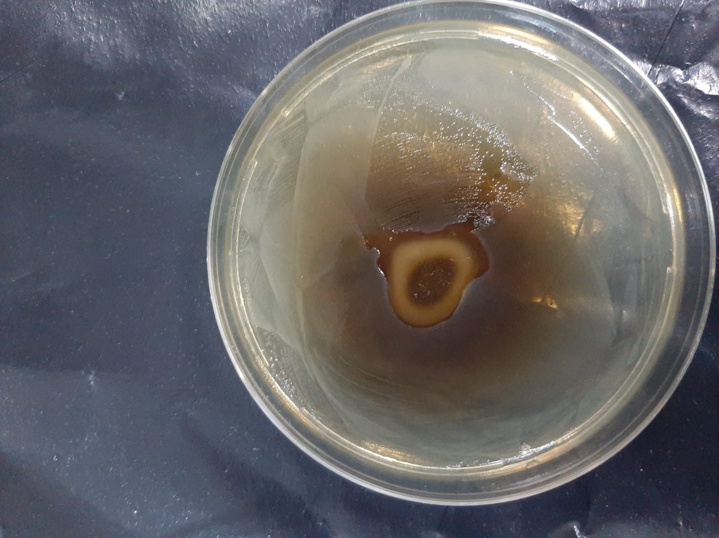
S. aureus
Gentamicin
TA
TA Fiber
Crosslinked TA Fiber
TA-Ibu Fiber
Crosslinked TA-Ibu Fiber
E. coli
Fig. 5. Digital camera images of TA and TA-based fibers against S. aureus (gram +) and E. coli (gram -) bacteria [gentamicin was used as a control].

